Slide 1
Software Vendors
COSS B03
Licensed under CC BY 4.0 International
Prof. Dr. Dirk Riehle | Dr. Thomas Otter
Friedrich-Alexander University Erlangen-Nürnberg | Otter Advisory
Notes:
It is Friedrich-Alexander University Erlangen-Nürnberg – FAU, in short.
Corporate identity wants us to say “Friedrich-Alexander University”.

Slide 2
Agenda
Products and vendors
Projects vs. product firms
The financial view
Business functions
Core business processes

Slide 3
1. Products and Vendors

Slide 4
The Main Types of Industry Players (Recap)
Standard product providers
  (Independent) software vendors (ISVs)
    Produce software products (“standard software” or “commercial off-the-shelf software”)
  Software service providers (e.g. “Internet companies”)
    Operate any form of software (and hardware)
Software consulting firms
  Development services firms
    Produce custom software
  Implementation services firms
    Configure software products for use by customers
Non-profit organizations
  Standards organizations
  Regulatory bodies
  Certification agencies

Slide 5
Core, Basic, and Whole Product (Recap)
Core product =
  Core software
  Additional functionality
  Complementary artifacts
  Self-help services
Basic product =
  Core product +
  Fitness for use
  Certification
  Support services
Whole product =
  Basic product +
  Training
  Consulting
  Operations

Slide 6
2. Product vs. Project Firms

Slide 7









Enterprise Software Products and Projects
Software vendor | Product | Consulting firm | Project
Widget Corp.
BI Impl. 2008
German SME
Sugar 2010
Continental
Stages 2010

Slide 8
Software Product Revenue
One-time license sale
revenue
Initial
one-time
license fee
Annual maintenance fee (~20% of initial fee)
1
2
3
4
5
time

Slide 9
Accumulating Traditional Software Product Revenue
One license sale per year
revenue
}
Base revenue
1
2
3
4
5
time

Slide 10
Accumulating Software Subscription Revenue
}
One subscription sale per year
revenue
Base revenue
2-3 times higher subscription than maintenance revenue
1
2
3
4
5
time

Slide 11
Software Projects
A project is an undertaking that
  Has a process with a defined start and a defined end
A software project is a project where
  Revenues correlate with performed labor
    Fixed price vs. actual labor
  Accounted for as revenue and expenses
Some examples projects
  Bachelor and Master theses
  Customizing SAP for a customer

Slide 12
Software Project Revenue
One project per year
revenue
Fees for
project
...
1
2
3
4
5
time

Slide 13
Software Product vs. Project Revenue
One license sale
Product
Revenues
One project sale
Project
Revenues
revenue
revenue
1
2
3
4
time
5
1
2
3
4
5
time
One license sale per year
One project sale per year
revenue
revenue
1
2
3
4
time
5
1
2
3
4
5
time

Slide 14
Software Product vs. Project Firms
 | Software vendor | Consulting firm
Advantages | Predictable revenue High valuation multiples | Not capital intensive Can be started easily Has simple pricing
Disadvantages | Hard to get started Requires investment Most fail, few survive | Somewhat fragile revenue Higher business volatility Limited scalability

Slide 15
3. The Financial View

Slide 16
The Three Statements of Financial Accounting
Balance sheet
  A summary (annual) statement of assets, liabilities, and equity
Income statement
  A summary (annual) statement of revenues and expenses
Cash-flow statement
  A summary (annual) of flow of cash (and cash equivalents)

Slide 17
The Income Statement
Basic vocabulary
  Revenues = income (sales)
  Expenses = costs
  Profit (loss) = revenues - expenses

Slide 18
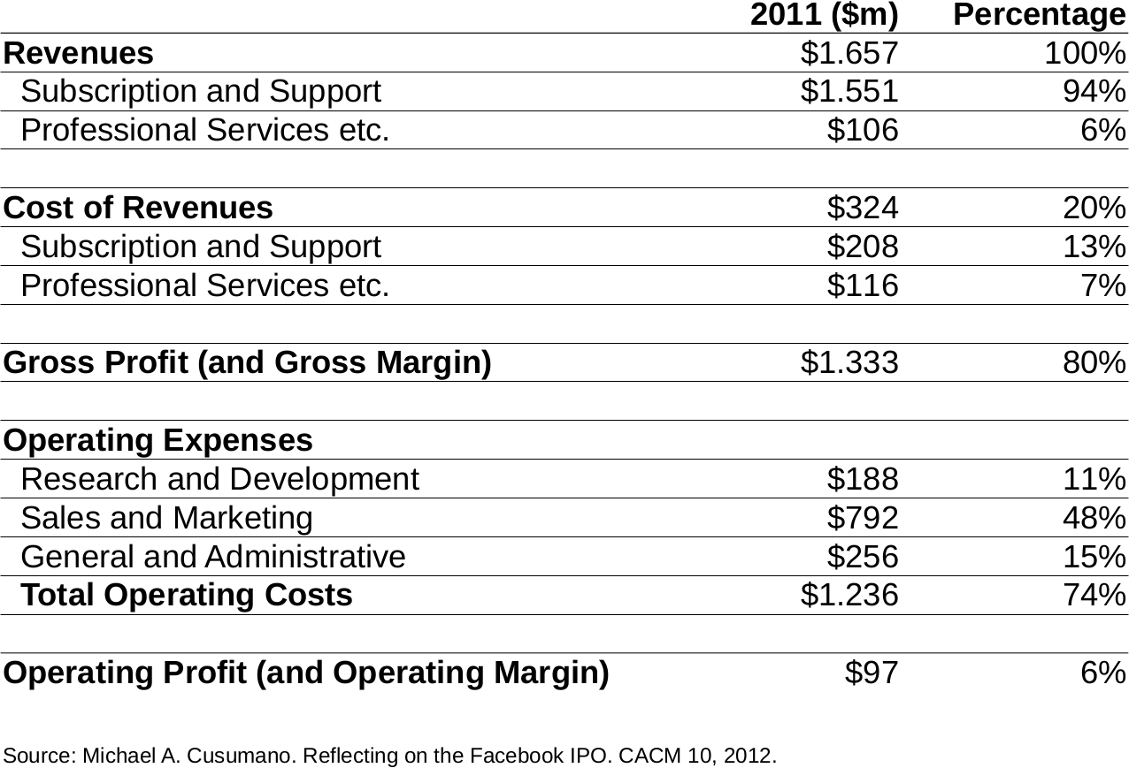

Slide 19
Quiz: Accenture vs. Salesforce (August 2020)
Metric | Ratio | Accenture | Salesforce
Market capitalization | ?? | ??
Revenue | US$ 43 billion | US$ 17 billion
Net income [1] | US$ 4,5 billion | US$ 0,1 billion
Price–sales ratio [2] | ?? | ??
Gross profit margin [3] | 30% | 74%
Operating profit margin | 15% | 2,94%
Net profit margin | 11% | 0,74%
Revenue growth | 4,4% | 29%
No employees | 510.000 | 49.000
Fix numbers
[1] Net income = revenue - cost of goods sold (COGS)
[2] Price-sales ratio = market capitalization / last year’s revenue
[3] Gross profit margin = net income / revenue

Slide 20
Accenture vs. Salesforce
Metric | Ratio | Accenture | Salesforce
Market capitalization | US$ 150 billion | US$ 244 billion
Revenue | US$ 43 billion | US$ 17 billion
Net income | US$ 4,5 billion | US$ 0,1 billion
Price–sales ratio | 3,58 | 9,06
Gross profit margin | 30% | 74%
Operating profit margin | 15% | 2,94%
Net profit margin | 11% | 0,74%
Revenue growth | 4,4% | 29%
No employees | 510.000 | 49.000

Slide 21
4. Business Functions

Slide 22
Key Business Functions and Processes
Sales and Marketing
Engineering
Professional
services
Product
management
Other (HR,
Finance, ...)
Sales
Marketing
Customer
success
Development
Operations
Support
1. Build product
2. Acquire customers
3. Operate product
4. Support customers
5. Ensure satisfaction

Slide 23
Product Management (Business Functions 1 / 9)
Roles / titles
  Chief product officer (CPO)
  Strategic product manager
  Technical product manager (e.g. Scrum product owner)
Responsibilities
  Identify and justify new business opportunities
  Define and prioritize product vision, roadmap, and features
Key stakeholder in
  Build product
  Acquire customers
  Ensure customer satisfaction

Slide 24
Development (Business Functions 2 / 9)
Roles / titles
  Developer / engineer
  Software architect [1]
  Engineering manager
Responsibilities
  Design, build, and evolve product
  Provide third-level support
Key stakeholder in
  Build product

Slide 25
Operations (Business Functions 3 / 9)
Roles / titles
  Site reliability engineer
  Operations manager
Responsibilities
  Operate product
  Provide third-level support
Key stakeholder in
  Operate product
  Support customers

Slide 26
Support (Business Functions 4 / 9)
Roles / titles
  Support engineer
  Support manager
Responsibilities
  Respond to support requests
  Build support automation
Key stakeholder in
  Support customers
May overlap with DevOps

Slide 27
Marketing (Business Functions 5 / 9)
Roles / titles
  (Marketeer)
  Marketing manager
Responsibilities
  Create brand awareness
  Generate demand
  Generate leads, qualify them
  Make product known (campaigns, webinars, etc.)
  Provide competitive intelligence
Key stakeholder in
  Acquire customers

Slide 28
Sales (Business Functions 6 / 9)
Roles / titles
  Sales person / representative
  Pre-sales (person)
  Sales manager
  Account manager
Responsibilities
  Turn qualified leads into customers
  Drive upsell, cross-sell, and renewals
Key stakeholder in
  Acquire customers

Slide 29
Customer Success (Business Functions 7 / 9)
Roles / titles
  Customer advocate
  Customer success manager
Responsibilities
  Ensure actual use
  Improve satisfaction
Key stakeholder in
  Ensure customer satisfaction

Slide 30
Professional Services (Business Functions 8 / 9)
Roles / titles
  Consultant
  Project manager
Responsibilities
  Help deploy the product (“solution”)
  Review partner consulting firm (work quality)
  Help manage consulting ecosystem
Key stakeholder in
  Ensure customer satisfaction

Slide 31
Other (Business Functions 9 / 9)
Human resources
  Supports hiring
  Ensures compliance
Finance
  Supports operations
  Manages expenses / costs
  Helps fundraising
  Ensures compliance

Slide 32
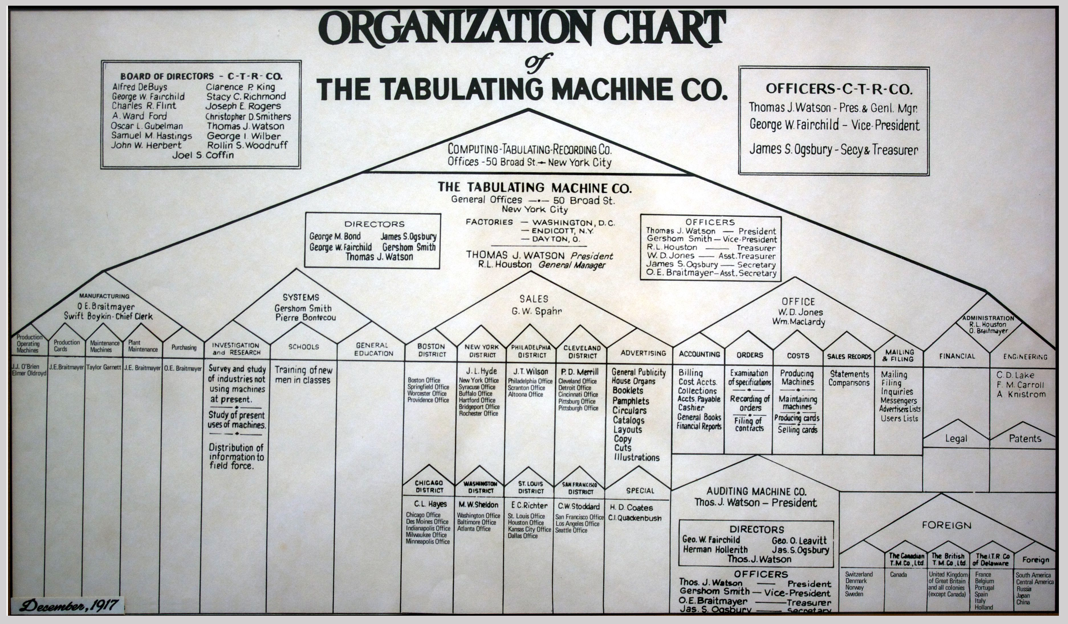

Slide 33
Titles and Careers in a Software Company
Sales
Marketing
Product Management
Development
VP of Sales
Chief Marketing Officer (CMO) or VP of Marketing
Chief Product Officer (CPO)
VP of Engineering
Chief Tech. Officer (CTO)
...
Sales manager
Marketing
manager
Strategic product manager
Engineering
manager
Software architect
Sales representative
Marketing
manager
Product manager
Developer
Business
Student
Engineering
Student

Slide 34
5. Core Business Processes

Slide 35
Profit Center vs. Cost Center
Profit center
  Generates revenue (“makes money”)
  Reason why company exists
Cost center
  Costs money
  Needed to operate (“hygiene factor”)

Slide 36
Managerial Hierarchy (Line Reporting)
CEO
CRO
CTO
CHRO
CFO
VP of
Sales
VP of
Marketing
VP of
Professional
Services
VP of
Product
Management
VP of
Engineering
Sales
Marketing
Customer
success
Professional
services
Product
management
Development
Operations
Human
resources
Human
resources

Slide 37
Core Business Processes
Product development (“build product”)
Customer acquisition (“acquire customers”)
Product operations (“operate product”)
Customer support (“support customers”)
Customer success (“ensure customer satisfaction”)

Slide 38
Product Development (Business Processes 1 / 5)
Product Management
Engineering
Other
SPM = Strategic product manager
TPM = Technical product manager
EM = Engineering manager
SD = Software developer
FM = Finance
HR = Human resources
SPM
EM
FM
TPM
SD
HR

Slide 39
Problems and Solutions to Product Development
Competent technical product managers are hard to find
  The engineering manager usually takes this role
The IT department gets stuck to product development
  Just say no (you can’t be both a cost and a profit center)

Slide 40
Customer Acquisition (Business Processes 2 / 5)
Sales
Marketing
Product Management
SR = Sales representative
MM = Marketing manager
PM = Product manager
}
Awareness
MM
PM
{
Discovery
Evaluation
SR
Intent
Buy

Slide 41
Problems and Solutions to Customer Acquisition
Marketing people don’t generate leads
  Strategic product manager reviews segments and channels
Sales people don’t understand the new product
  Explain better, provide stronger incentives, split org. unit
Sales people keep selling the old product
  Change incentives, split org. unit

Slide 42
Product Operations (Business Processes 3 / 5)
Development
Operations
Support
SRE = Site reliability engineer
OM = Operations manager
OP = Operator
SE = Support engineer
EM
OM
SM
SRE
SD
OP
SM

Slide 43
Problems and Solutions to Product Operations
Your service simply does not meet reliability requirements
  In engineering, hire differently
    Hire for cloud computing skill set
    Hire for site reliability engineering skill set

Slide 44
Customer Support (Business Processes 4 / 5)
Product Management
Support
Dev Ops
SPM
SM
EM
TPM
SE
OP

Slide 45
Customer Success (Business Processes 5 / 5)
Customer Success
Professional Services
Product Management
CA = Customer advocate
CSM = Customer success manager
C = Consultant
PM = Project manager
SPM = Strategic product manager
CA
C
SPM
CSM
PM

Slide 46
Summary
Products and vendors
Projects vs. product firms
The financial view
Business functions
Core business processes

Slide 47
Thank you! Questions?
dirk.riehle@fau.de – http://osr.cs.fau.de
dirk@riehle.org – http://dirkriehle.com – @dirkriehle
DR

Slide 48
Credits and License
Original version
  © 2020 Dirk Riehle, some rights reserved
  Licensed under Creative Commons Attribution 4.0 International License
Contributions
  None yet

Slide 49
Thomas’ Reading Recommendations
Dave Kellogg https://kellblog.com/
SaaStr: https://www.saastr.com/
SaaS CFO: https://www.thesaascfo.com/
BVP cloud index: https://www.bvp.com/bvp-nasdaq-emerging-cloud-index
Other VC sites, for instance Insight Partners.
Benioff’s books on Salesforce
Andrew McAfee and Erik Brynjoifsonn
Unicorn Project Gene Kim
Project to Product Mik Kersten

